Slide 1
Digital Image Processing Technology and Application
Image Enhancement
(Spatial Filtering)

Slide 2
Contents
In this lecture we will look at spatial filtering techniques:
  Basic of spatial filtering
  Smoothing spatial filters
    Smoothing linear filters
    Order-statistics filters
  Sharpening spatial filters
    1st derivative filters
    2nd derivative filters

Slide 3
Basic of spatial filtering
Neighbourhood operations simply operate on a larger neighbourhood of pixels than point operations
Neighbourhoods are
mostly a rectangle
around a central pixel
Any size rectangle
and any shape filter
are possible
Origin
y
(x, y)
Neighbourhood
x
Image f (x, y)

Slide 4
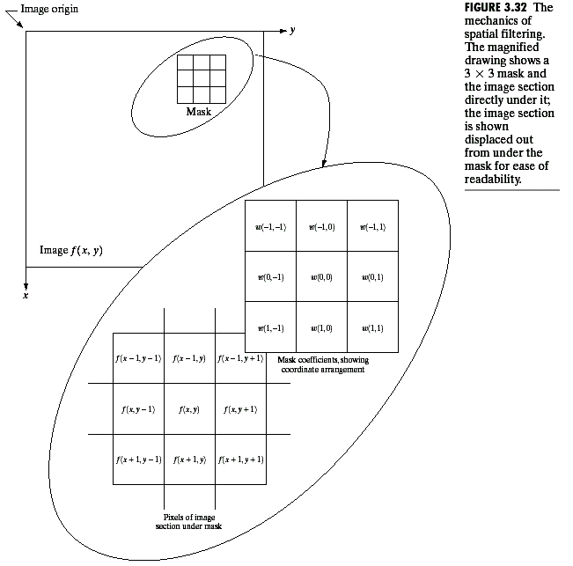
Basic of spatial filtering
Use of spatial masks for image processing (spatial filters)
  Linear filters
  Nonlinear filters

Slide 5
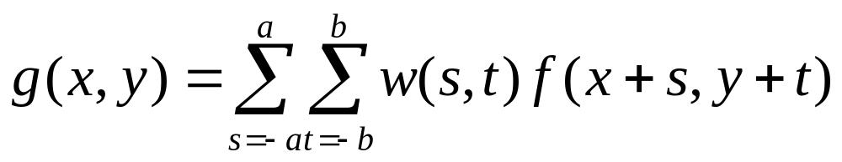
Spatial linear filtering
For linear filters:
  Filtering can be given in equation form as shown above
  Notations are based on the image shown before
  m x n (odd numbers)
  a=(m-1)/2 and b=(n-1)/2

Slide 6
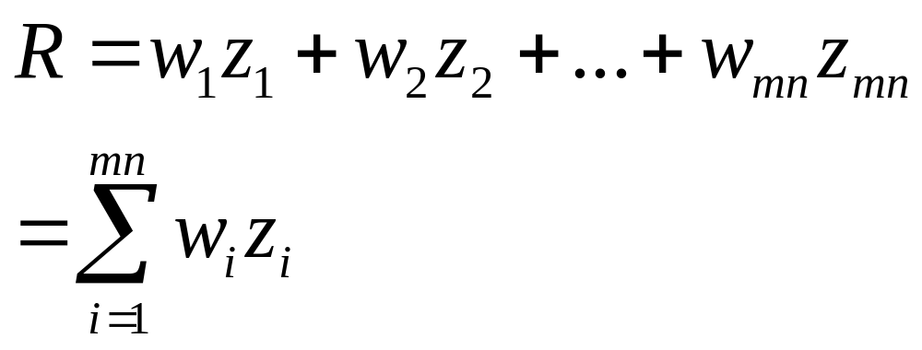
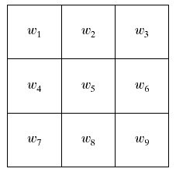
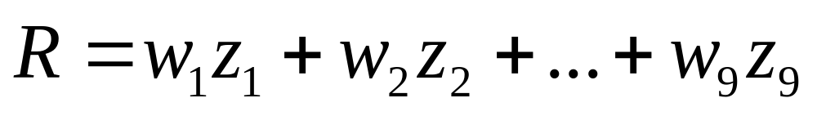
Spatial linear filtering
The basic approach is to sum products between the mask coefficients and the intensities of the pixels under the mask at a specific location in the image:
(for a 3 x 3 filter)

Slide 7
Strange Things Happen At The Edges!
At the edges of an image we are missing pixels to form a neighbourhood
Origin
y
e
e
e
e
e
e
e
x
Image f (x, y)

Slide 8
Strange Things Happen At The Edges! (cont…)
There are a few approaches to dealing with missing edge pixels:
  Omit missing pixels
    Can add extra code and slow down processing
  Pad the image
    Typically with either all white or all black pixels
  Replicate border pixels
  Truncate the image

Slide 9
Spatial smoothing filtering
Used for noise reduction and blurring (removal of small details prior to large object extraction, bridging small gaps in lines).
Smoothing linear filters
Order-statistics filters

Slide 10
Smoothing linear Filters
Also called averaging filter
  Simply average all of the pixels in a neighbourhood around a central value
  Especially useful
  in removing noise
  from images
  Also useful for
  highlighting gross
  features
¹/₉ | ¹/₉ | ¹/₉
¹/₉ | ¹/₉ | ¹/₉
¹/₉ | ¹/₉ | ¹/₉

Slide 11
Smoothing linear Filters
Origin
y
104
100
108
¹/₉
¹/₉
¹/₉
99
106
98
*
¹/₉
¹/₉
¹/₉
95
90
85
¹/₉
¹/₉
¹/₉
Original Image Pixels
Filter
¹/₉
¹/₉
¹/₉
Simple 3*3
Neighbourhood
104
100
108
3*3 Smoothing
Filter
¹/₉
¹/₉
¹/₉
99
106
98
¹/₉
¹/₉
¹/₉
95
90
85
e = ¹/₉*106 +
¹/₉*104 + ¹/₉*100 + ¹/₉*108 +
¹/₉*99 + ¹/₉*98 +
¹/₉*95 + ¹/₉*90 + ¹/₉*85
= 98.3333≈98
x
Image f (x, y)
The above is repeated for every pixel in the original image to generate the smoothed image.

Slide 12
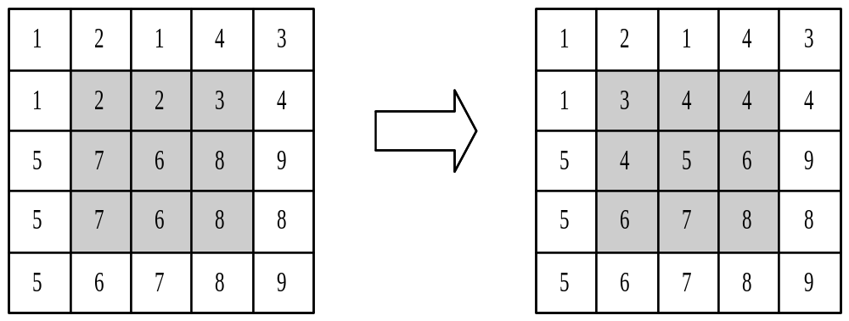
Smoothing linear Filters
¹/₉
¹/₉
¹/₉
¹/₉
¹/₉
¹/₉
¹/₉
¹/₉
¹/₉

Slide 13
Smoothing linear Filters
More effective smoothing filters can be generated by allowing different pixels in the neighbourhood different weights in the averaging function:
  Pixels closer to the
  central pixel are more
  important
  Often referred to as a
  weighted averaging
¹/₁₆ | ²/₁₆ | ¹/₁₆
²/₁₆ | ⁴/₁₆ | ²/₁₆
¹/₁₆ | ²/₁₆ | ¹/₁₆
Weighted averaging filter

Slide 14
Smoothing linear Filters
This process results in an image with reduced sharp transitions in gray levels.
Because random noise typically consists of sharp transitions in gray levels, the most obvious application of smoothing is noise reduction.
Averaging filters have the undesirable side effect that they blur edges.
A major use of averaging filters is in the reduction of “irrelevant” detail in an image.

Slide 15
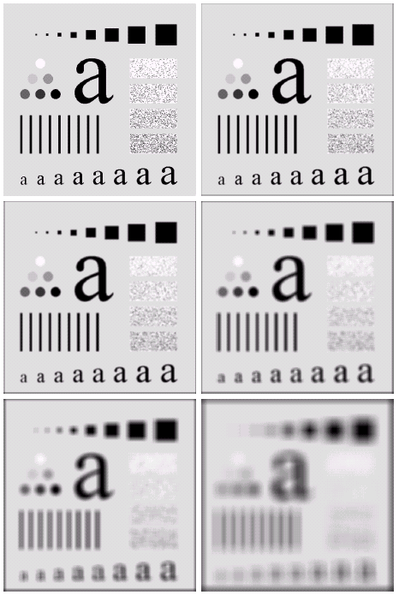
Smoothing linear Filters
The image at the top left
is an original image of
size 500*500 pixels
The subsequent images
show the image after
filtering with an averaging
filter of increasing sizes
  3, 5, 9, 15 and 35
Notice how detail begins
to disappear
Exam: average.m

Slide 16
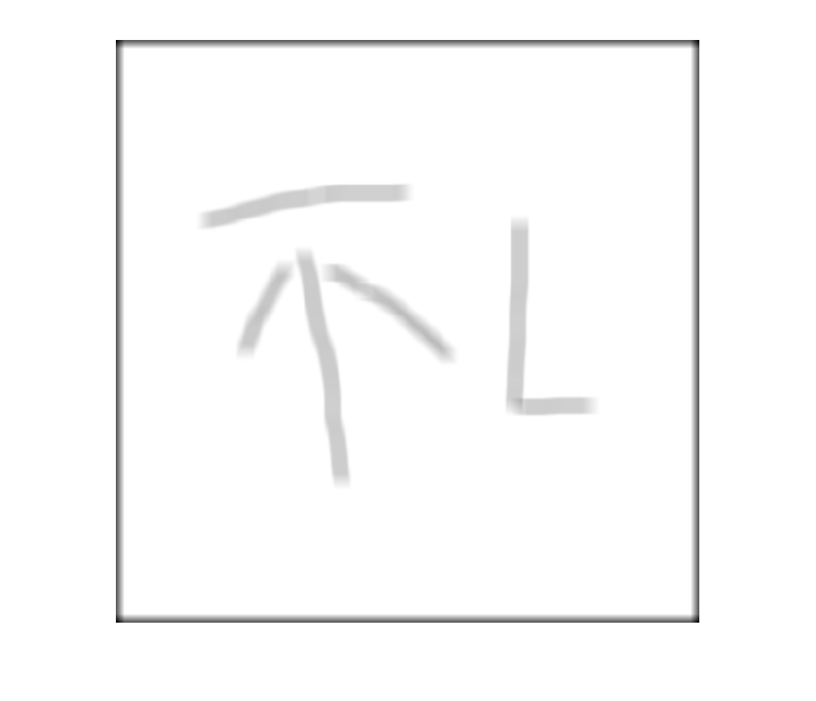
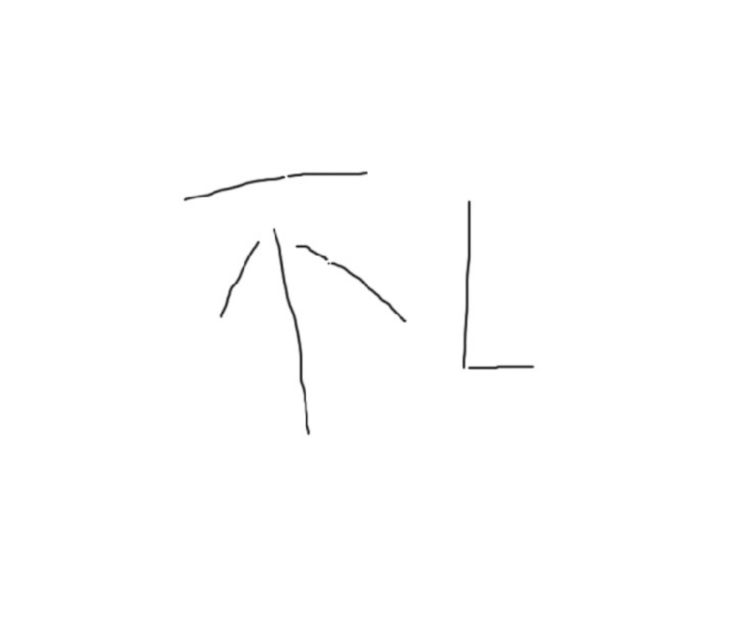
Smoothing linear Filters
Exam: word.m

Slide 17
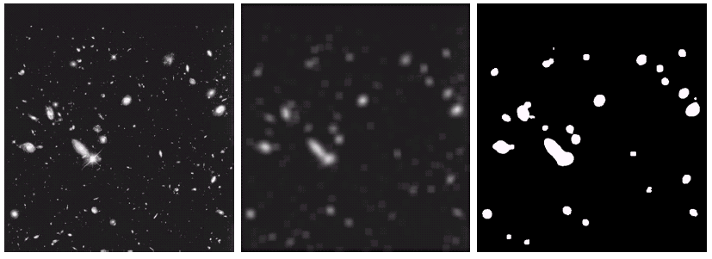
Smoothing linear Filters
By smoothing the original image we get rid of lots of the finer detail which leaves only the gross features for thresholding.
Original Image
Smoothed Image
Thresholded Image
Exam: hubble.m

Slide 18
Order-statistics filters
Order statistics filters are nonlinear spatial filters whose response is based on ordering the pixels in the area of filter.
Some typical operations include:
  Min: Set the pixel value to the minimum in the neighbourhood
  Max: Set the pixel value to the maximum in the neighbourhood
  Median: The median value of a set of numbers is the midpoint value in that set (e.g. for a 3*3 neighbourhood, with grey level (10,20,20,20,15,20,20,25,100), then we can order them in (10,15,20,20,20,20,20,25,100),20 is the median. Sometimes the median works better than the average

Slide 19

Order-statistics filters
Original Image
With Noise
Image After
Averaging Filter
Image After
Median Filter
Exam: order.m

Slide 20
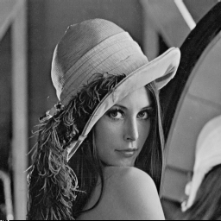

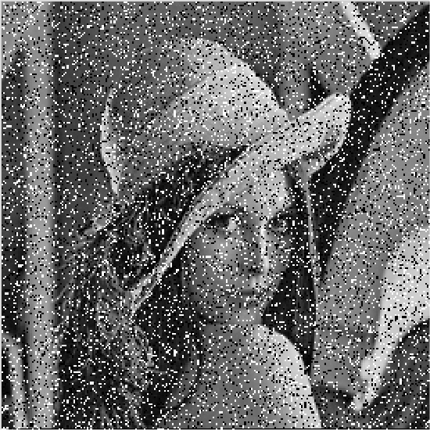
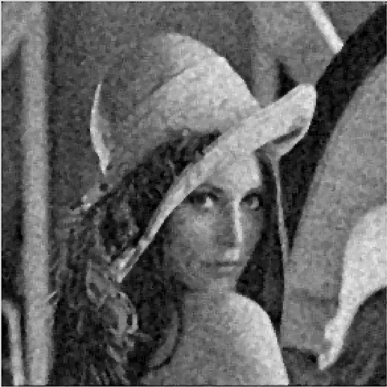
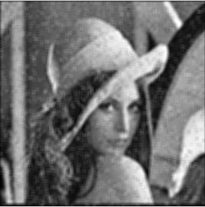


Order-statistics filters
Exam: order2.m
a
b
c
d
e
f
g
(a) Lena; (b) Gaussian noise；(c) Salt and pepper noise; (d) and (e) Smoothing with square average filter on (b) and (c), respectively; (f) and (g) 5×5 median filter on (b) and (c), respectively.

Slide 21
Order-statistics filters
Filtering is often used to remove noise from images.
Sometimes a median filter works better than an averaging filter.
Median filter are particularly effective in the presence of impulse noise, also called salt-and-pepper noise.

Slide 22
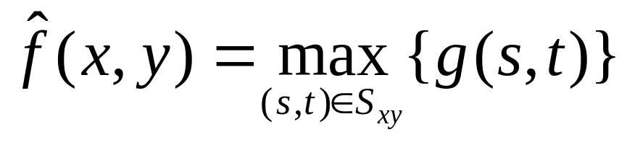
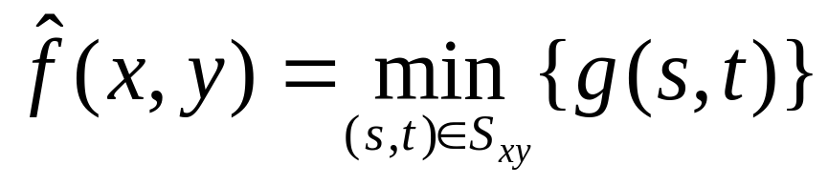
Max and Min Filter
Max Filter:
Min Filter:
Max filter is good for pepper noise and min is good for salt noise

Slide 23
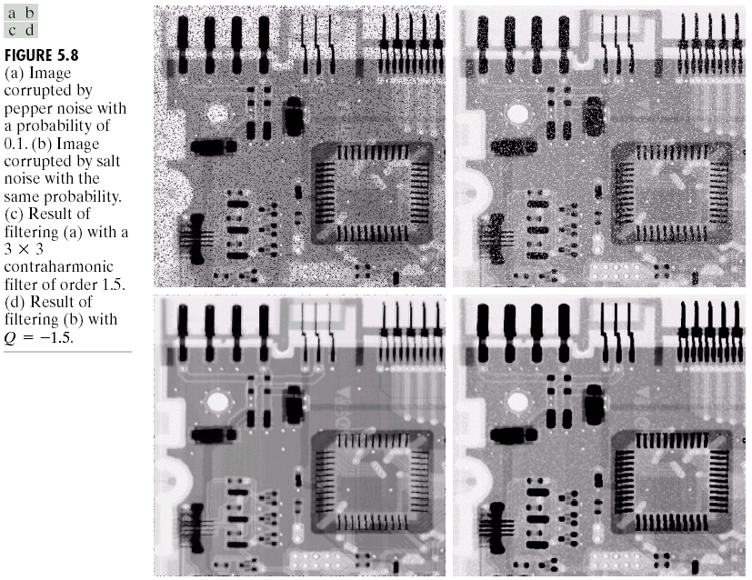
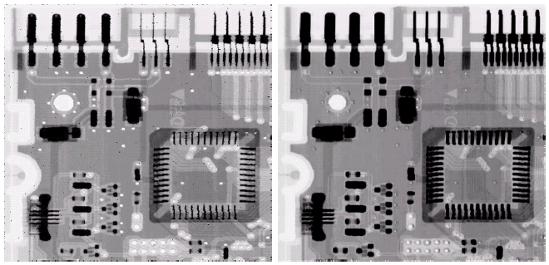
Noise Removal Examples (cont…)
Image
Corrupted
By Pepper
Noise
Image
Corrupted
By Salt
Noise
Result Of
Filtering
Above
With A 3*3
Max Filter
Result Of
Filtering
Above
With A 3*3
Min Filter
Example: maxminfilter.m

Slide 24
Noise Removal Examples (cont…)
  For max filter, it will remove pepper noise, but it also removed some dark pixels from the borders of dark objects.
  The same as min filter, it will remove some white points around the border of light objects.

Slide 25
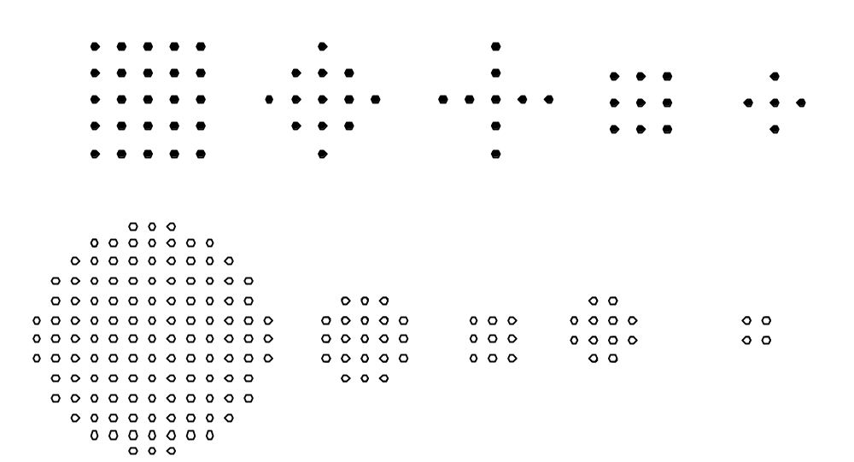
Order-statistics filters
Other typical filter masks

Slide 26
Adaptive Filters
The filters discussed so far are applied to an entire image without any regard for how image characteristics vary from one point to another.
The behaviour of adaptive filters changes depending on the characteristics of the image inside the filter region.
An increase in filter complexity.
We will take a look at the adaptive median filter.

Slide 27
Adaptive Median Filtering
The median filter performs relatively well on impulse noise as long as the spatial density of the impulse noise is not large (P_{a} and P_{b} are less than 0.2).
The adaptive median filter can handle much more spatially dense impulse noise, and also performs some smoothing for non-impulse noise.
An additional benefit of the adaptive median filter is that it seeks to preserve detail while smoothing non-impulse noise.
The key insight in the adaptive median filter is that the filter size changes depending on the characteristics of the image.

Slide 28
Adaptive Median Filtering (cont…)
Remember that filtering looks at each original pixel image in turn and generates a new filtered pixel.
First examine the following notation:
  z_{min} = minimum grey level in S_{xy}
  z_{max} = maximum grey level in S_{xy}
  z_{med} = median of grey levels in S_{xy}
  z_{xy} = grey level at coordinates (x, y)
  S_{max} = maximum allowed size of S_{xy}

Slide 29
Adaptive Median Filtering (cont…)
The key to understanding the algorithm is to remember that the adaptive median filter has three purposes:
  Remove impulse noise
  Provide smoothing of other noise
  Reduce distortion, by not changing these intermediate-level points. (excessive thinning or thickening of object boundaries)

Slide 30
Adaptive Median Filtering (cont…)
Level A: A1 = z_{med} – z_{min}
A2 = z_{med} – z_{max}
If A1 > 0 and A2 < 0, Go to level B
Else increase the window size
If window size ≤ S_{max} repeat level A
Else output z_{med}
Level B: B1 = z_{xy} – z_{min}
B2 = z_{xy} – z_{max}
If B1 > 0 and B2 < 0, output z_{xy}
Else output z_{med}
Z_{med} is an impulse?
Z_{xy} is an impulse?

Slide 31
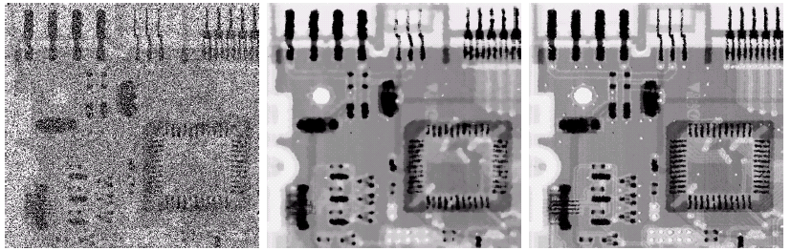
Adaptive Filtering Example
Image corrupted by salt and pepper noise with probabilities P_{a} = P_{b}=0.25
Result of filtering with a 7 * 7 median filter
Result of adaptive median filtering with s_{max} = 7
Choice of maximum allowed window size depends on the application. It should be increased as the density of the impulse increases.
A reasonable value can be estimated by experiment with various sizes of standard median filter.

Slide 32
Sharpening Spatial Filters
Previously we have looked at smoothing filters which remove fine detail.
Sharpening spatial filters seek to highlight fine detail:
  Remove blurring from images
  Highlight edges
Averaging is analogous to integration and causes blurring, so differentiation is expected to have opposite results and sharpen an image.
  smoothing ~ integration
  sharpening ~ differentiation

Slide 33
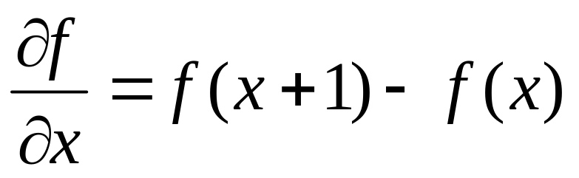
1st Derivative
The formula for the 1st derivative of a function is as follows:
It’s just the difference between subsequent values and measures the rate of change of the function.

Slide 34
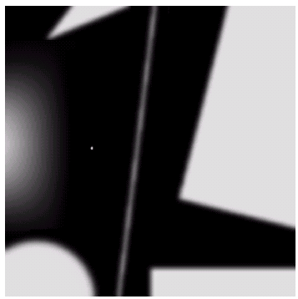
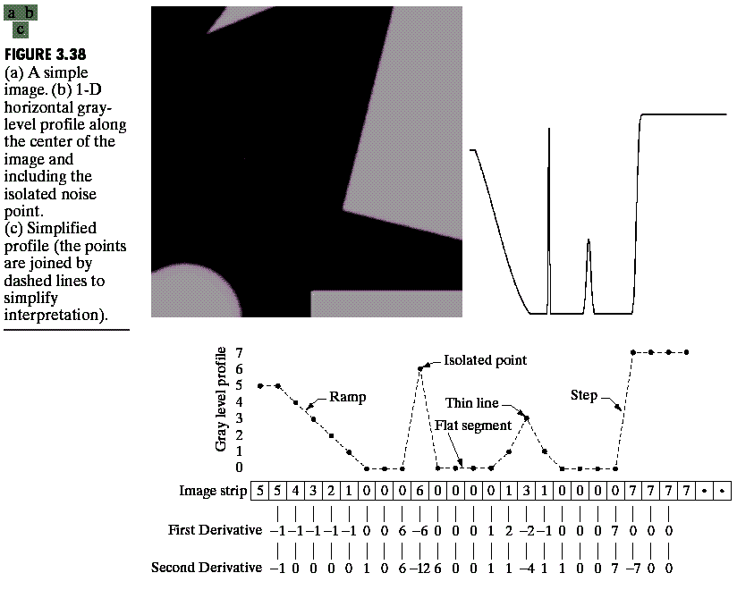
Spatial Differentiation
Differentiation measures the rate of change of a function.
Let’s consider a simple one dimensional example.

Slide 35
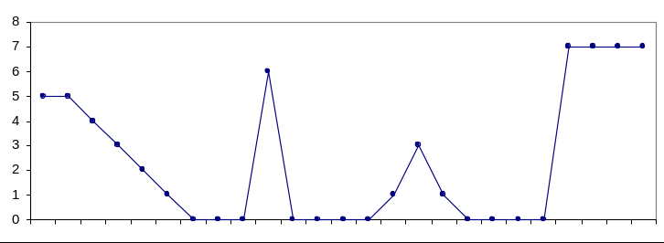
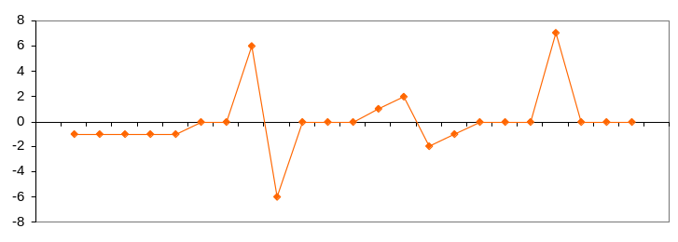
1st Derivative (cont…)
First derivative:
  0 in constant gray segments
  Non-zero at the onset of steps or ramps
  Non-zero along ramps
5 | 5 | 4 | 3 | 2 | 1 | 0 | 0 | 0 | 6 | 0 | 0 | 0 | 0 | 1 | 3 | 1 | 0 | 0 | 0 | 0 | 7 | 7 | 7 | 7
 | -1 | -1 | -1 | -1 | -1 | 0 | 0 | 6 | -6 | 0 | 0 | 0 | 1 | 2 | -2 | -1 | 0 | 0 | 0 | 7 | 0 | 0 | 0

Slide 36
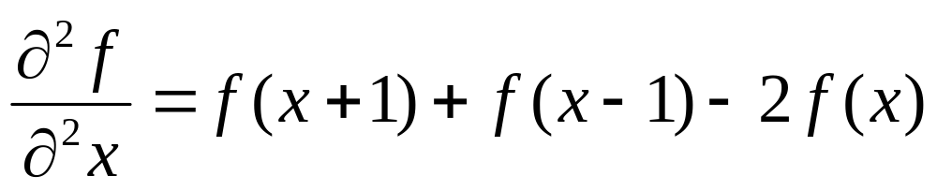
2nd Derivative
The formula for the 2nd derivative of a function is as follows:
Simply takes into account the values both before and after the current value.

Slide 37
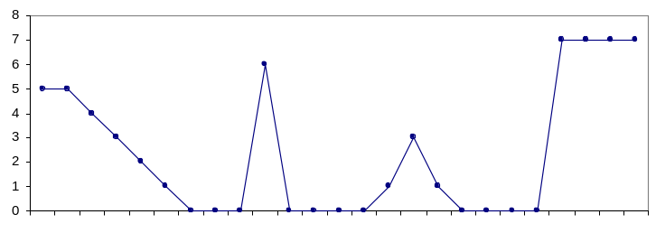
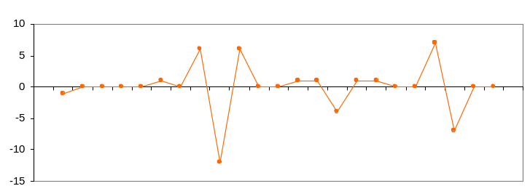
2nd Derivative (cont…)
Second derivative:
  0 in constant gray segments.
  Non-zero at the onset and end of steps or ramps.
  0 along ramps of constant slope. (Wrong in text book, page 98).
5 | 5 | 4 | 3 | 2 | 1 | 0 | 0 | 0 | 6 | 0 | 0 | 0 | 0 | 1 | 3 | 1 | 0 | 0 | 0 | 0 | 7 | 7 | 7 | 7
 | -1 | 0 | 0 | 0 | 0 | 1 | 0 | 6 | -12 | 6 | 0 | 0 | 1 | 1 | -4 | 1 | 1 | 0 | 0 | 7 | -7 | 0 | 0

Slide 38
1st & 2st Derivative (cont…)
Comparing the 1st and 2nd derivatives we can conclude the following:
  1st order derivatives generally produce thicker edges.
  2nd order derivatives have a stronger response to fine detail e.g. thin lines, and isolated points.
  1st order derivatives have stronger response to grey level step.
  2nd order derivatives produce a double response at step changes in grey level.

Slide 39
Using Second Derivatives For Image Enhancement
The 2nd derivative is more useful for image enhancement than the 1st derivative
  Stronger response to fine detail
  Simpler implementation
  We will come back to the 1st order derivative later on
The first sharpening filter we will look at is the Laplacian
  Isotropic
  One of the simplest sharpening filters
  We will look at a digital implementation

Slide 40
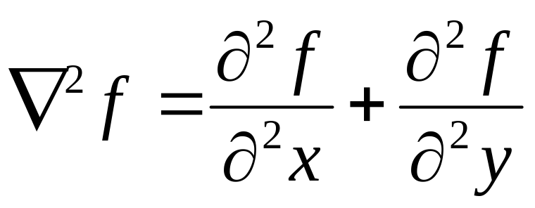
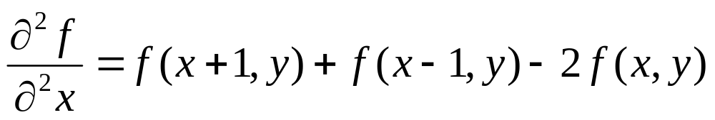
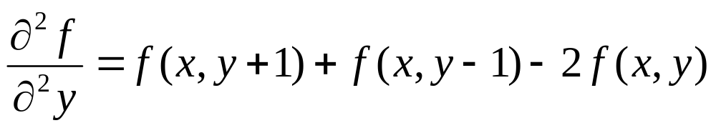
The Laplacian
The Laplacian is defined as follows:
where the partial 1st order derivative in the x direction is defined as follows:
and in the y direction as follows:

Slide 41
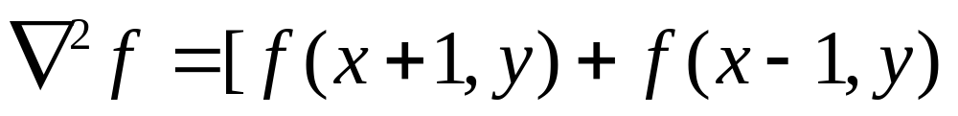
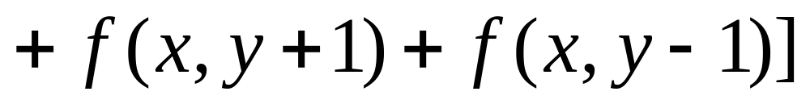
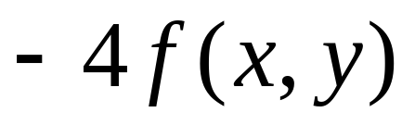
The Laplacian (cont…)
So, the Laplacian can be given as follows:
We can easily build a filter based on this
0
1
0
1
-4
1
0
1
0

Slide 42
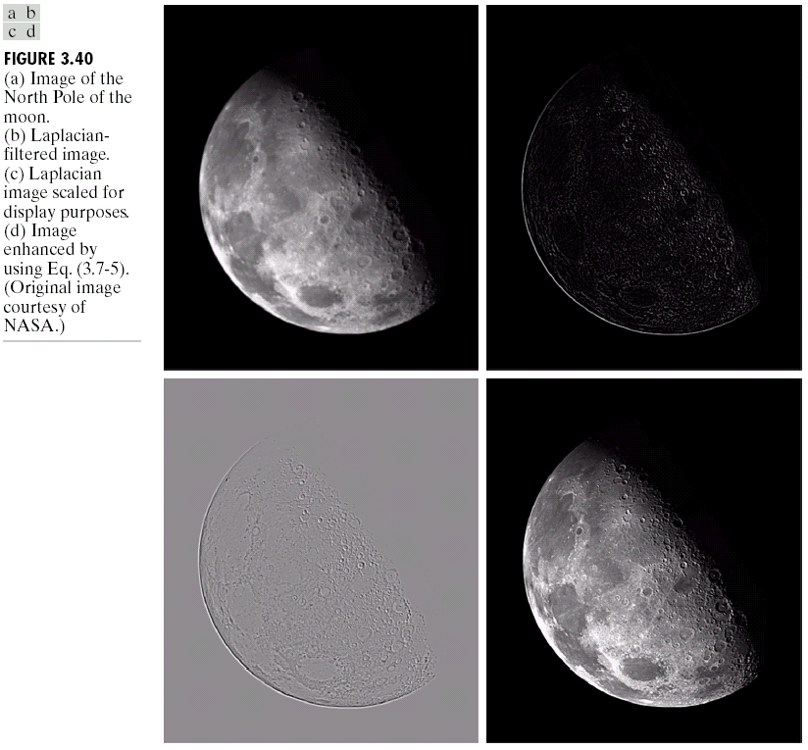
The Laplacian (cont…)
Applying the Laplacian to an image we get a new image that highlights edges and other discontinuities
Original
Image
Laplacian
Filtered Image
Laplacian
Filtered Image
Scaled for Display

Slide 43
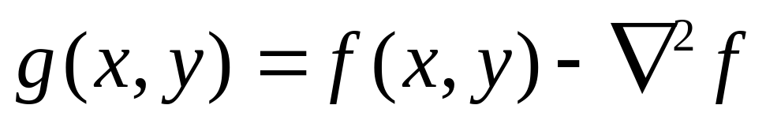
But That Is Not Very Enhanced!
The result of a Laplacian filtering is not an enhanced image.
We have to do more work in order to get our final image.
Subtract the Laplacian result from the original image to generate our final sharpened enhanced image.
Laplacian
Filtered Image
Scaled for Display

Slide 44
Laplacian Image Enhancement
-
=
Original
Image
Laplacian
Filtered Image
Sharpened
Image
In the final sharpened image edges and fine detail are much more obvious.
Exam: laplacian.m

Slide 45
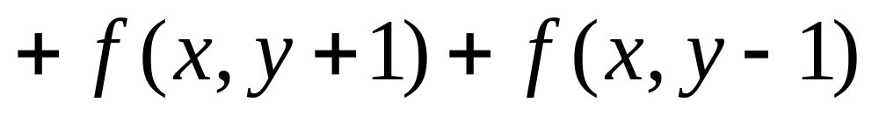
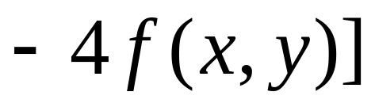
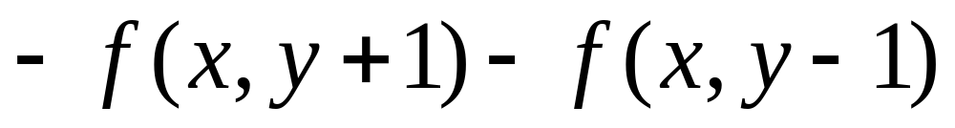
Simplified Image Enhancement
The entire enhancement can be combined into a single filtering operation:

Slide 46
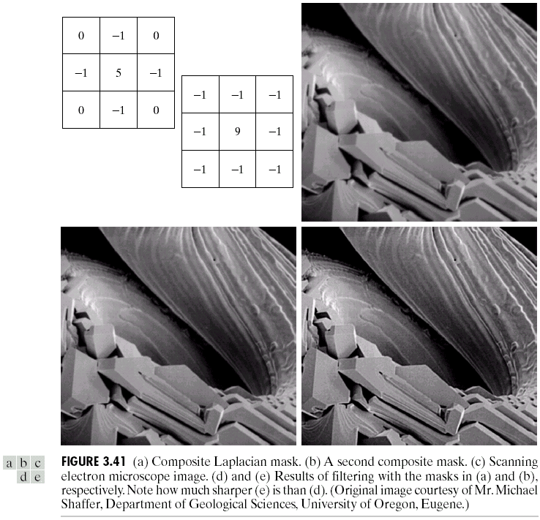
Simplified Image Enhancement (cont…)
This gives us a new filter which does the whole job for us in one step.
0
-1
0
-1
5
-1
0
-1
0

Slide 47
Variants On The Simple Laplacian
There are lots of slightly different versions of the Laplacian that can be used:
0
1
0
1
1
1
Simple
Laplacian
Variant of
Laplacian
1
-4
1
1
-8
1
0
1
0
1
1
1
-1
-1
-1
-1
9
-1
-1
-1
-1

Slide 48
Variants On The Simple Laplacian

Slide 49
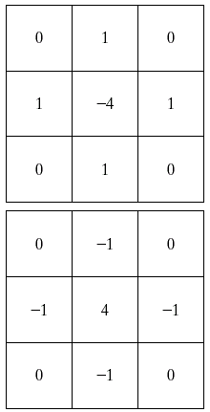
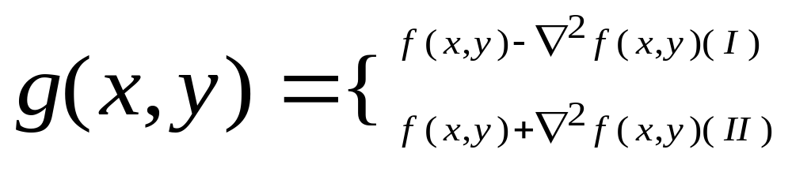
Variants On The Simple Laplacian
Two definitions of Laplacian: one is the negative of the other
Accordingly, to recover background features:
I: if the center of the mask is negative
II: if the center of the mask is positive

Slide 50
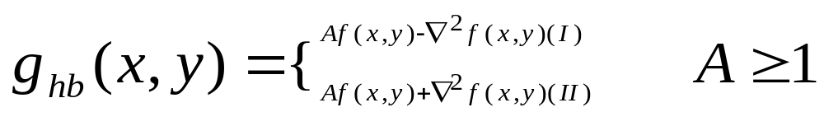
High Boost Filtering
High boost filtering:
I: if the center of the mask is negative
II: if the center of the mask is positive
When A=1, it is the standard Laplacian filtering, as the value of A increase past 1, the contribution of the sharpening process becomes less and less important.

Slide 51
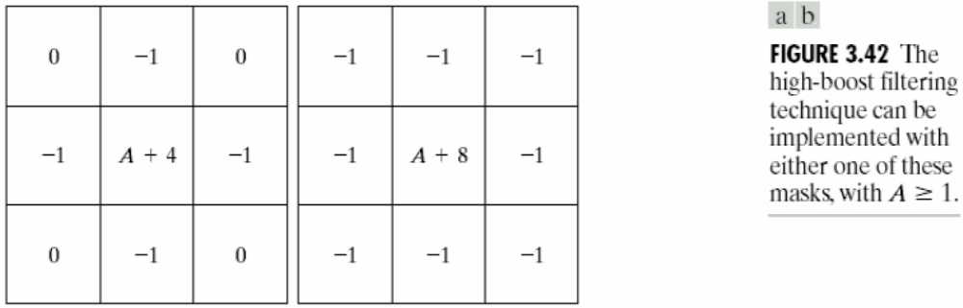
High Boost Filtering
One of the principal applications of boost filtering is when the input image is darker than desired.
By varying the boost coefficient, it generally is possible to obtain an overall increase in average gray level of the image.

Slide 52
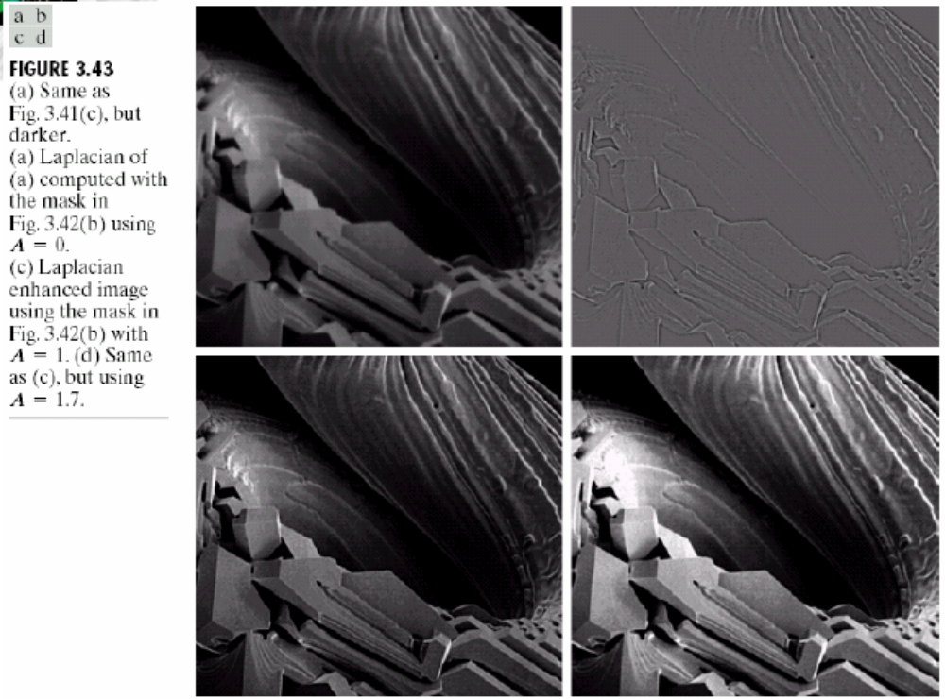
High Boost Filtering
1
1
1
1
-8
1
1
1
1

Slide 53
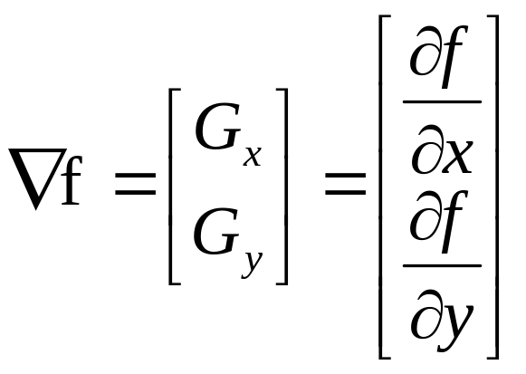
1st Derivative Filtering
Implementing 1st derivative filters is difficult in practice
For a function f(x, y) the gradient of f at coordinates (x, y) is given as the column vector:

Slide 54
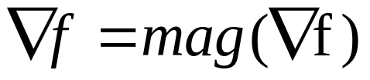
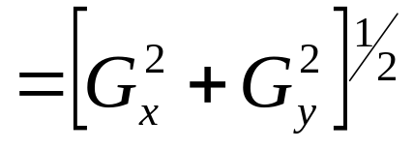
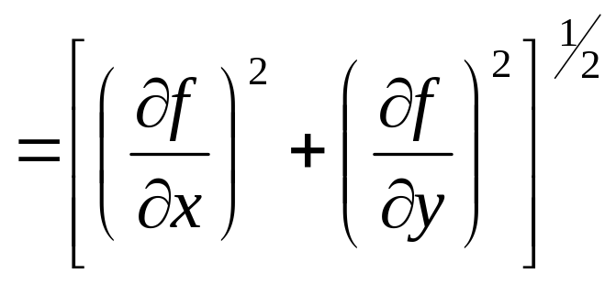
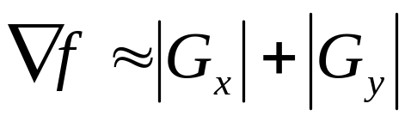
1st Derivative Filtering (cont…)
The magnitude of this vector is given by:
For practical reasons this can be simplified as:

Slide 55



1st Derivative Filtering (cont…)
The simplest 1st Derivative Filtering:
Approximation:
z₁
z₂
z₃
z₄
z₅
z₆
z₇
z₈
z₉

Slide 56



1st Derivative Filtering (cont…)
Roberts uses:
Approximation (Roberts Cross-Gradient Operators):

Slide 57


1st Derivative Filtering (cont…)
Image sharpening by gradient

Slide 58


1st Derivative Filtering (cont…)
There is some debate as to how best to calculate these gradients but we will use:
which is based on these coordinates
z₁
z₂
z₃
z₄
z₅
z₆
z₇
z₈
z₉

Slide 59
Sobel Operators
Based on the previous equations we can derive the Sobel Operators.
To filter an image it is filtered using both operators the results of which are added together.
-1
-2
-1
-1
0
1
0
0
0
-2
0
2
1
2
1
-1
0
1

Slide 60

Sobel Example
Sobel filters are typically used for edge detection
An image of a contact lens which is enhanced in order to make defects (at four and five o’clock in the image) more obvious

Slide 61


Sobel Example
Exam: sobel2.m

Slide 62

Combining Spatial Enhancement Methods
Successful image enhancement is typically not achieved using a single operation.
Rather we combine a range of techniques in order to achieve a final result.
This example will focus on enhancing the bone scan to the right.

Slide 63
Combining Spatial Enhancement Methods (cont…)
Image (d) smoothed with a 5*5 averaging filter
(a)
Laplacian filter of bone scan (a)
(b)
Sharpened version of bone scan achieved by subtracting (a) and (b)
(c)
Sobel filter of bone scan (a)
(d)

Slide 64

Combining Spatial Enhancement Methods (cont…)
Result of applying a power-law trans. to (g)
(h)
Sharpened image which is sum of (a) and (f)
(g)
The product of (c) and (e) which will be used as a mask
(f)
(e)

Slide 65
Combining Spatial Enhancement Methods (cont…)
Compare the original and final images

Slide 66
Summary
In this lecture we have looked at the idea of spatial filtering and in particular:
  Basic of spatial filtering
  Smoothing spatial filters
    Smoothing linear filters
    Order-statistics filters
  Sharpening spatial filters
    1st derivative filters
    2nd derivative filters
Next time we will looking at other image enhancement methods in frequency domain.

